Slide 1





Gorilla Online Eye Tracking Workshop
UiT The Arctic University of Norway
May 3rd & 5th 2021

Slide 2
Schedule for May 3rd
Time | Event | Presenter
9:00 – 12:00 (Break 15min) | Basics of eye tracking How does eye tracking work? What can the VWP tell us? What’s the difference between online and real-life eye tracking? | Natalia Mitrofanova Bjørn Lundquist
12:00 – 13:00 (Lunch)
13:00 – 15:00 (Break 15min) | Designing a visual world paradigm Creating lists/linguistic stimuli Creating auditory stimuli | Maki Kubota

Slide 3
Schedule for May 5th
Time | Event | Presenter
9:00 – 12:00 (Break 15min) | Creating an eye tracking study in Gorilla Structure of Gorilla Eye tracking beta in Gorilla Explaining the output | Maki Kubota
12:00 – 13:00 (Lunch)
13:00 – 15:00 (Break 15min) | Data analysis Data cleaning Visualzation Statistical analysis | Martin Schweinberger Serge Minor

Slide 4

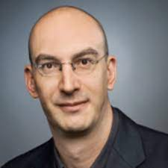

Thank you to Holger for sharing his materials!
Thank you to Theres for sharing her powerpoint!

Slide 5
Designing a visual world paradigm

Slide 6
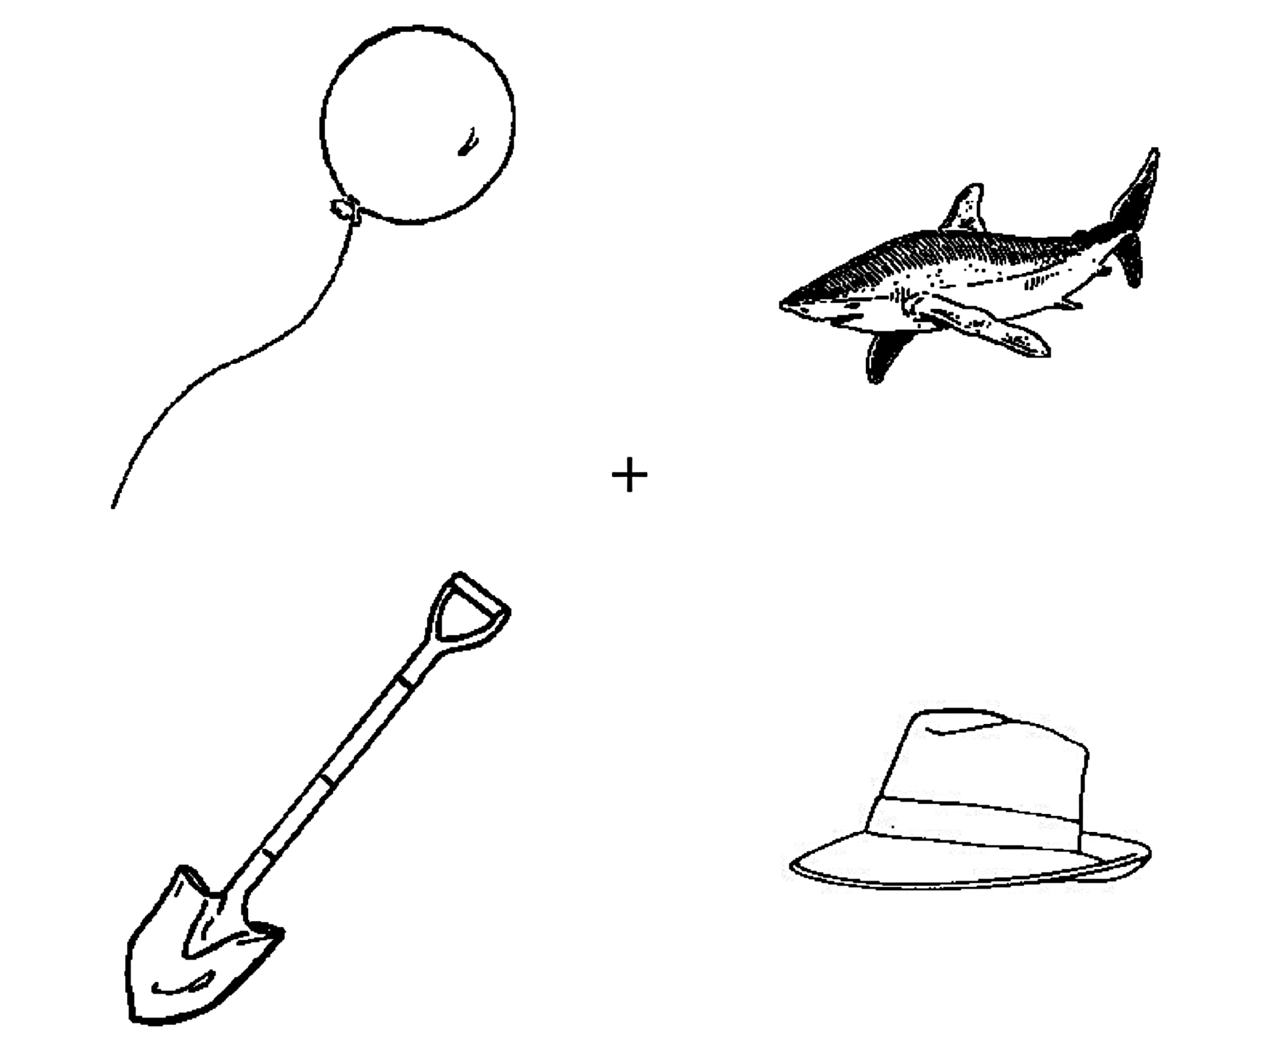
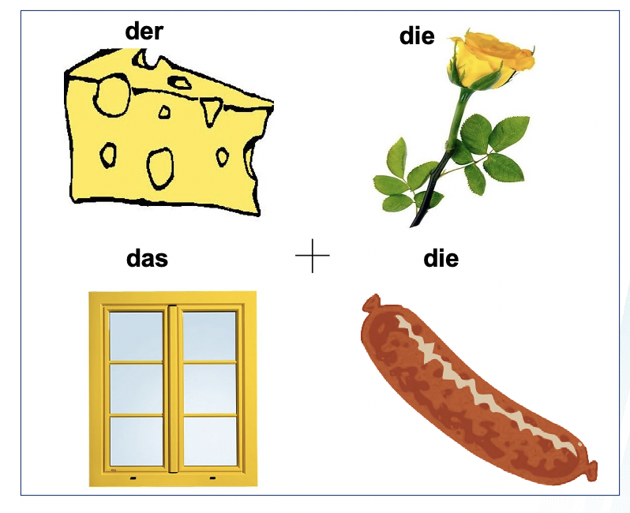
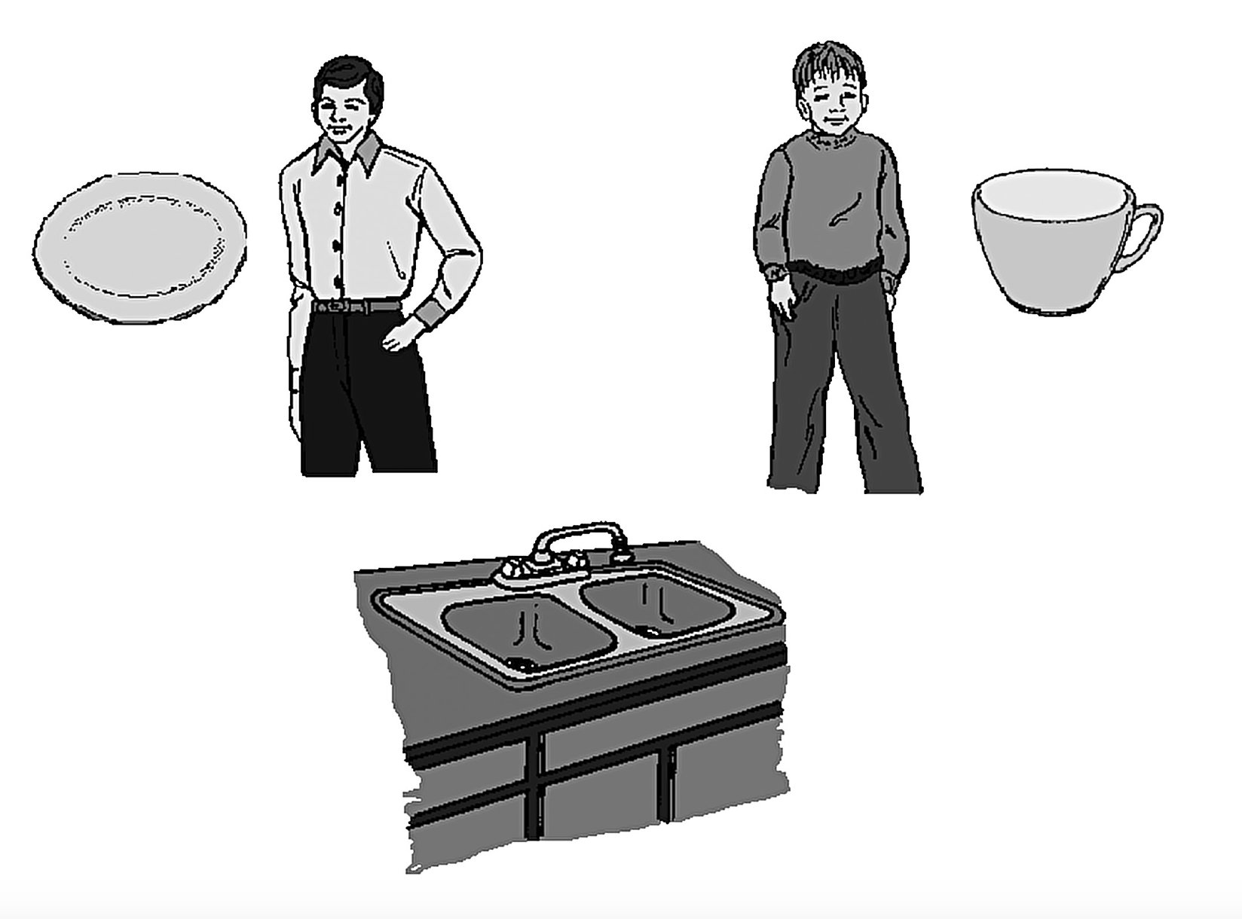
Visual world paradigm
While Peter helped Mr Smith by the sink in the kitchen, he carefully….
Wo ist das gelbe…
ʃαrik
shark
shovel
Marian & Spivey (2003)
Hopp (2016)
Cunnings (2017)
Word Recognition
Prediction
Referential Processing
6/32 studies
16/32 studies
4/32 studies

Slide 7
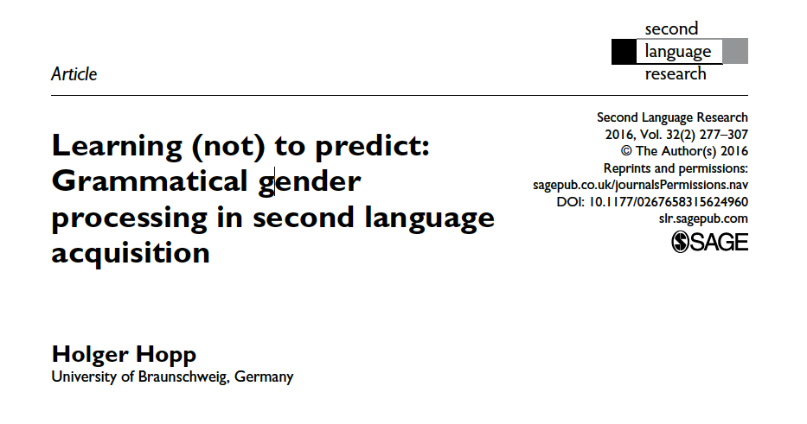

Slide 8
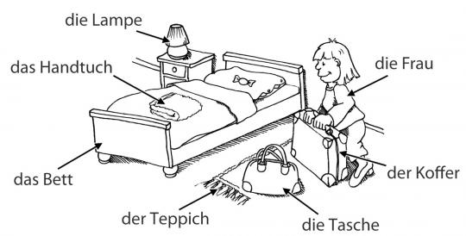
Predictive processing of gender

Slide 9
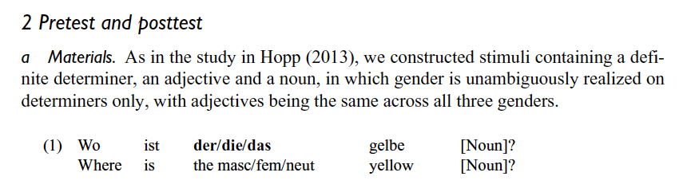
Gender cue
Prediction window

Slide 10
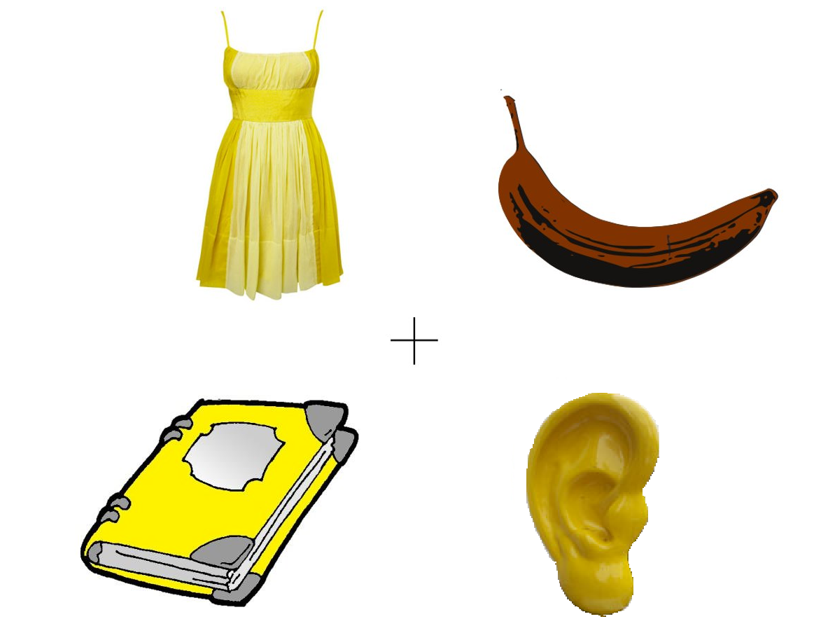
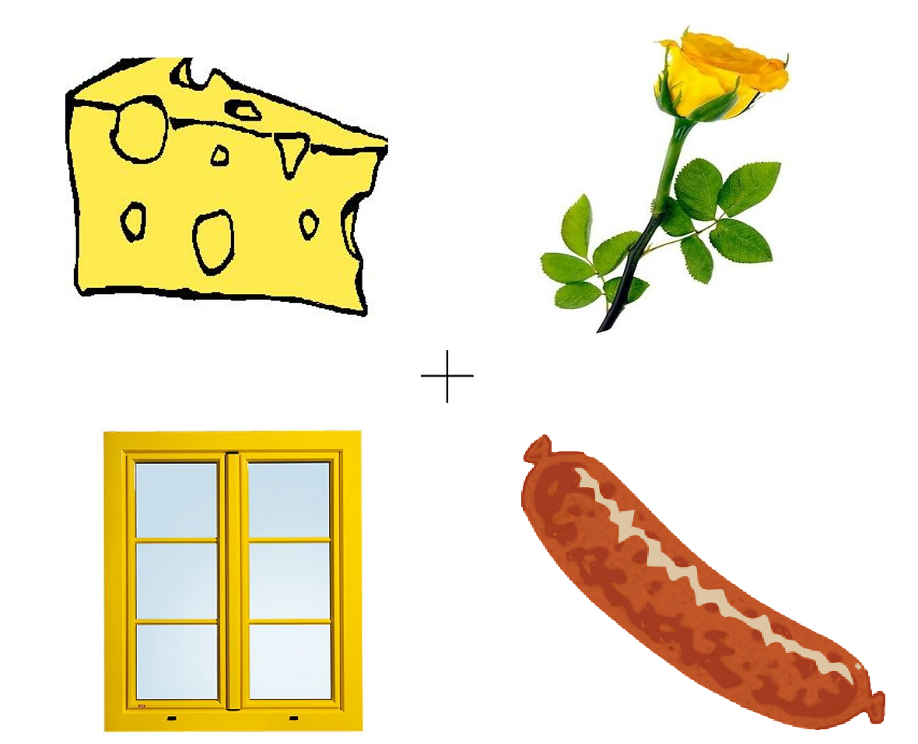
Wo ist das gelbe…
Where is
yellow
das
die
der
die
das
das
die
das
Same Condition
Different Condition

Slide 11
Wo ist das gelbe…
Where is
yellow
target
target
Same Condition
Different Condition

Slide 12
Wo ist das gelbe…
Where is
yellow
competitor 1
competitor 2
target
competitor 1
competitor 2
target
Same Condition
Different Condition

Slide 13
Wo ist das gelbe…
Where is
yellow
competitor 1
target
distractor
competitor 2
target
competitor 2
distractor
competitor 1
Same Condition
Different Condition

Slide 14
Let’s try designing our own mini-gender experiment (But keep it simple)!

Slide 15

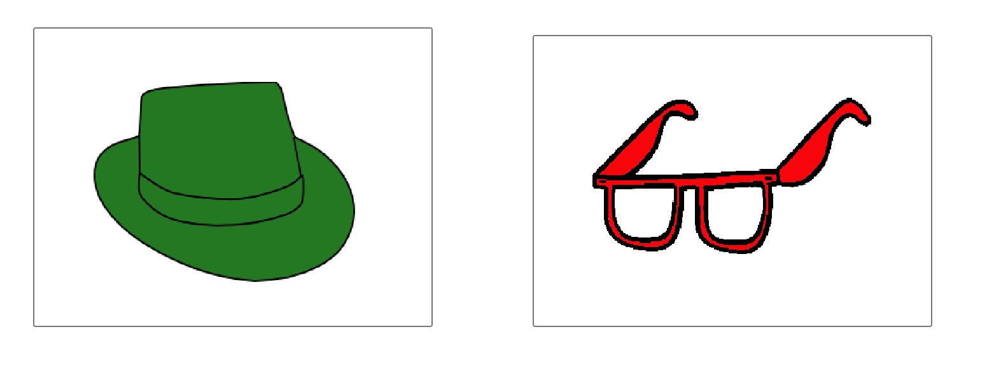
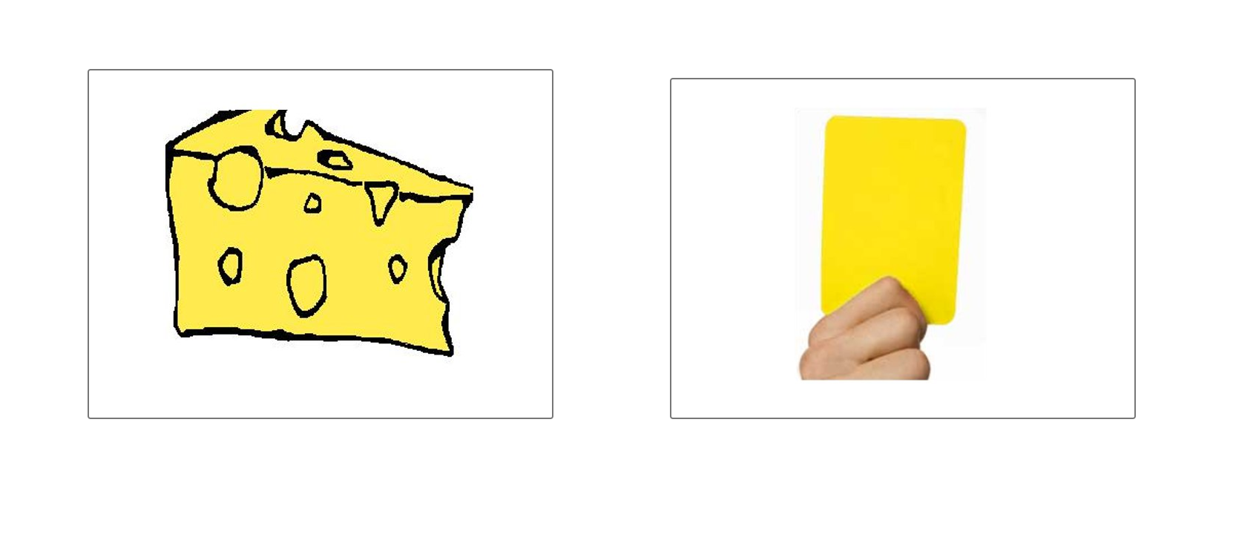
die
die
Same Condition
der
die
Colour/Filler Condition
Different Condition

Slide 16
Let’s reverse engineer the methodology
In this eye-tracking experiment, there were 18 trials in total.
The experimental trials consisted of (a) same condition (N = 6), (b)different condition (N = 6) and (c) filler condition (N = 6).
There were 2 trials for each of the three gender forms in each condition.

Slide 17
Let’s reverse engineer the methodology
In this eye-tracking experiment, there were 18 trials in total.
The experimental trials consisted of (a) same condition (N = 6), (b)different condition (N = 6) and (c) filler condition (N = 6).
There were 2 trials for each of the three gender forms in each condition.

Slide 18
Let’s reverse engineer the methodology
In this eye-tracking experiment, there were 18 trials in total.
The experimental trials consisted of (a) same condition (N = 6), (b)different condition (N = 6) and (c) filler condition (N = 6).
There were 2 trials for each of the three gender forms in each condition.

Slide 19
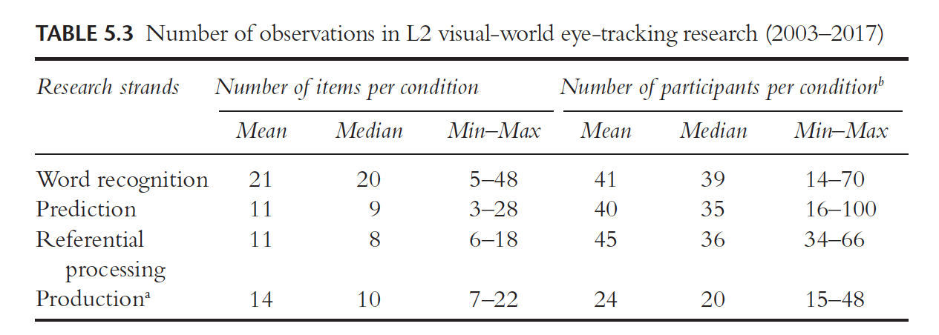
How many items are necessary?
Godfroid (2020)

Slide 20
Rule of Thumb
Median cell size in contemporary L2 eye-tracking research is close to 300, which corresponds to 15 participants x 20 items or 20 participants x 15 items items per condition. (Godfroid, 2020)
But…
We may need more than this number for online eye tracking since there is much more noise in the data!
Run power analysis/simulation using simr or Gpower
Report reliability by doing split-half reliability test

Slide 21
What is the task?
Primary Task
Look while listening
Clicking /Clicking and Dragging
Secondary Task (Before or After the Primary task)
Comprehension questions
Grammaticality Judgement Task
Translation
Plausibility Judgement
Production Tasks

Slide 22
Der Käse
1. Production
2. Eye tracking

Slide 23
Things to consider in a secondary task
Comprehension questions cannot be answered based on real-world knowledge
Do not repeat target words or structures in the comprehension questions or answer options
Think about priming effects if you are running a secondary task before the primary…perhaps you would like to have some time in between the primary and the secondary task to avoid priming effects.

Slide 24
Let’s reverse engineer the methodology
The target item never occurred twice across all conditions.
2 lists were created. Each object/noun served as a target in one list and as a competitor in other list.
Position of the target was counterbalanced for both lists.

Slide 25
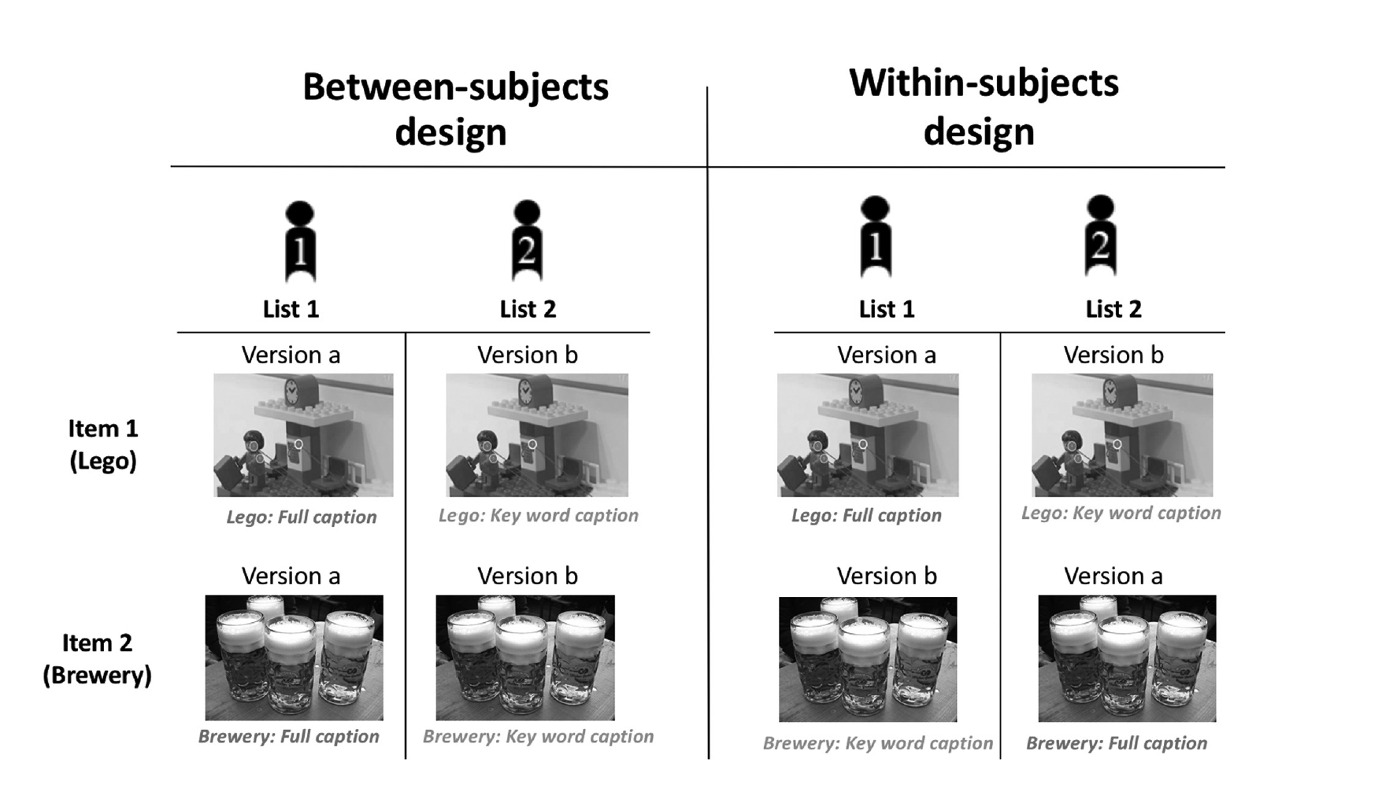
Godfroid (2020)

Slide 26
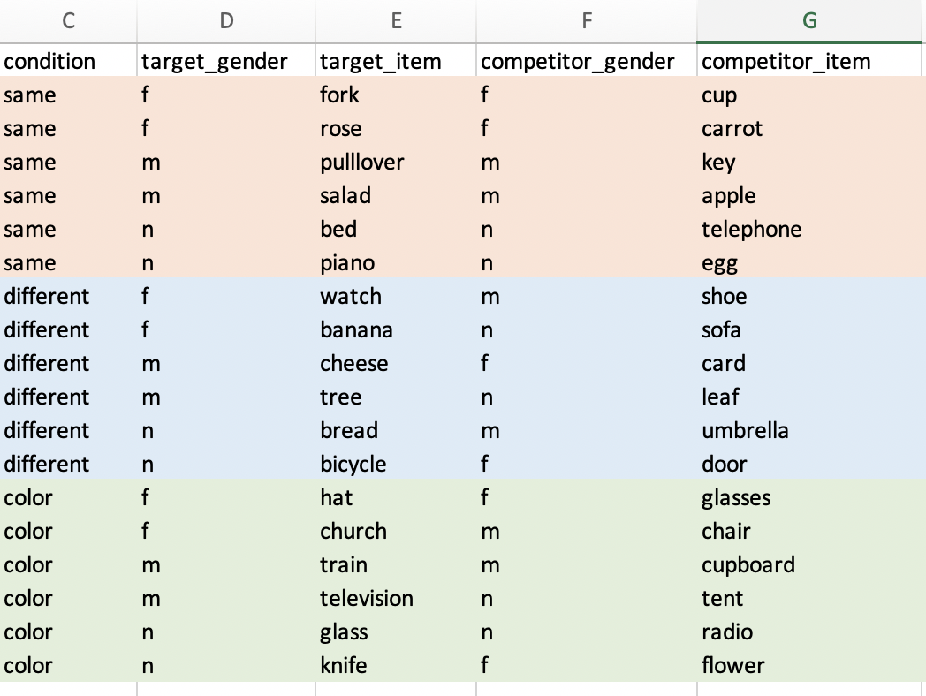

Slide 27
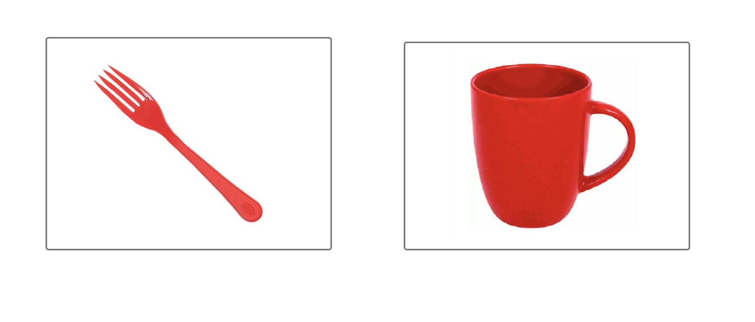

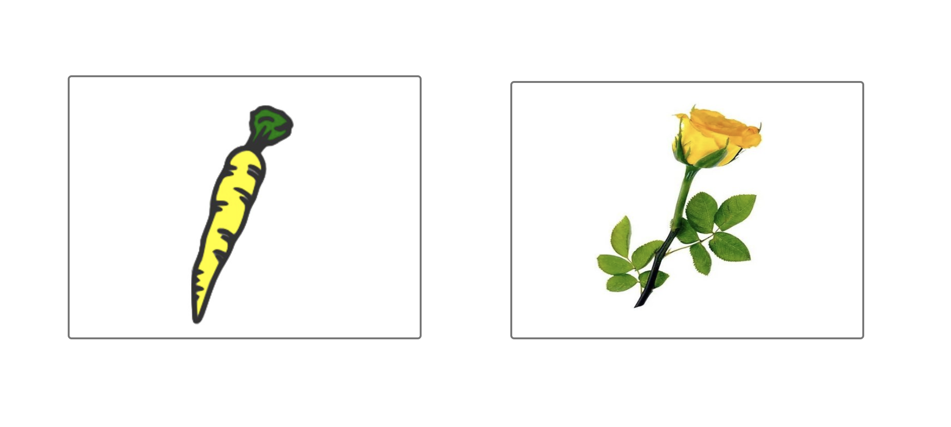
List gets complex as variables increase…
Fem. Target
Fem. Competitor
Tenedor
(Masc.)
Incongruent with Spanish gender
Congruent with Spanish gender
Rosa
(Fem.)

Slide 28
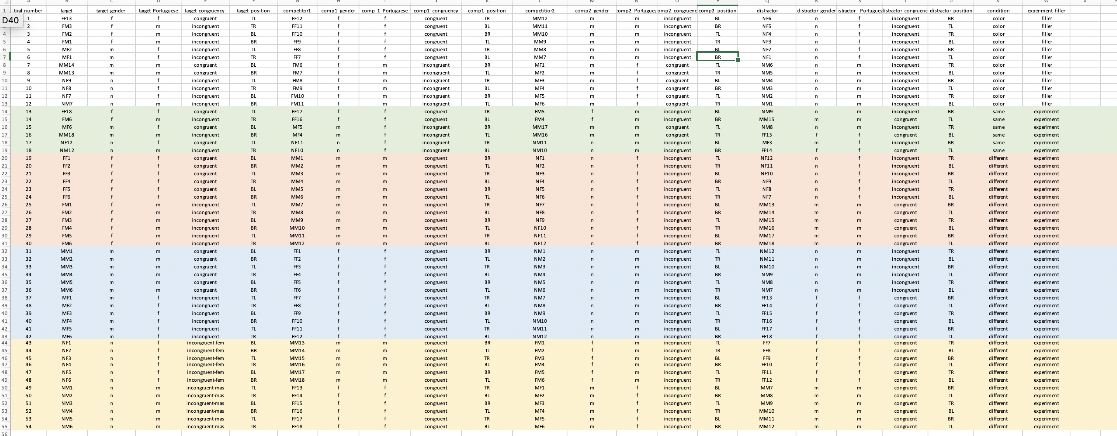

Slide 29
Let’s reverse engineer the methodology
The target item never occurred twice across all conditions.
2 lists were created. Each object/noun served as a target in one list and as a competitor in other list.
Position of the target was counterbalanced for both lists.

Slide 30
Three big headaches in eye tracking
Frequency
Contextual constraint or predictability
Word length

Slide 31
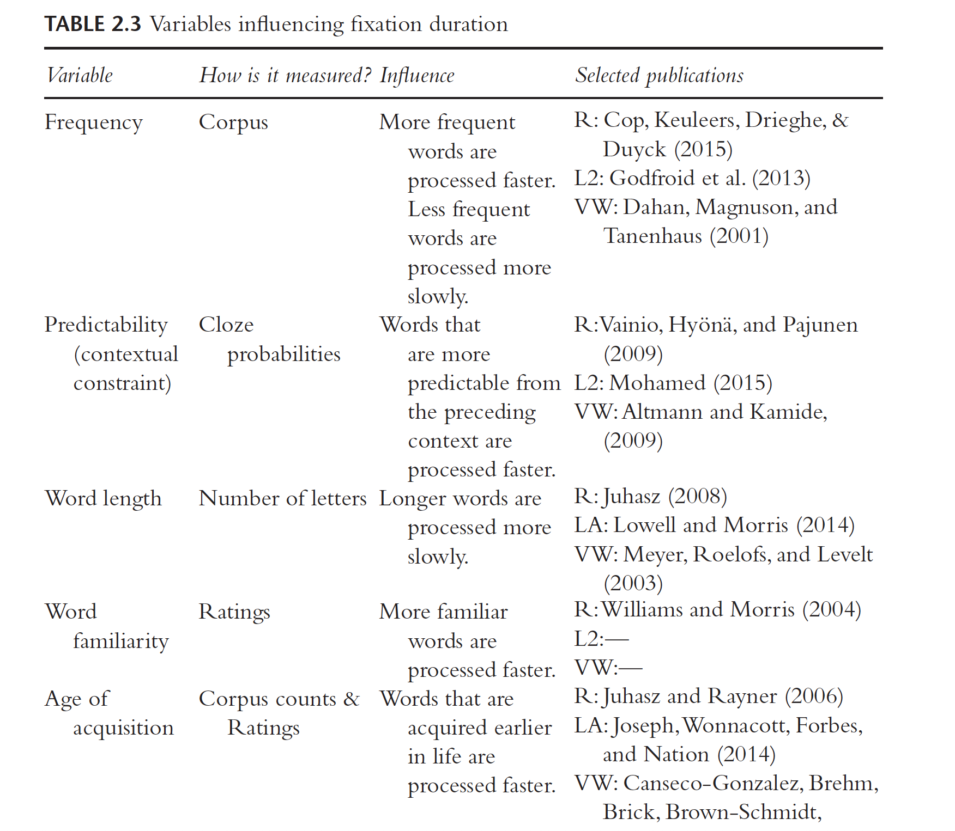

Slide 32
Frequency
Know the profile of your speakers! Are they children/adults? Simultaneous or sequential bilinguals? What’s their proficiency?
How often do your speakers encounter these words?
Look at the corpus (if available in your language) and see how frequent the word is.
Control for influence from the other language such as cognates, homophones
If you can’t control for frequency, then include it in the statistical model as a covariate.

Slide 33
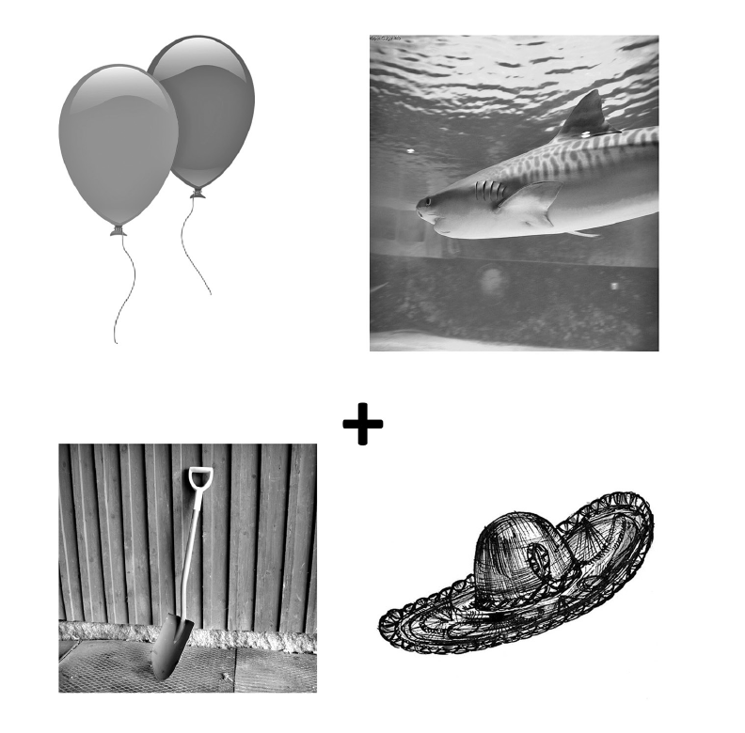
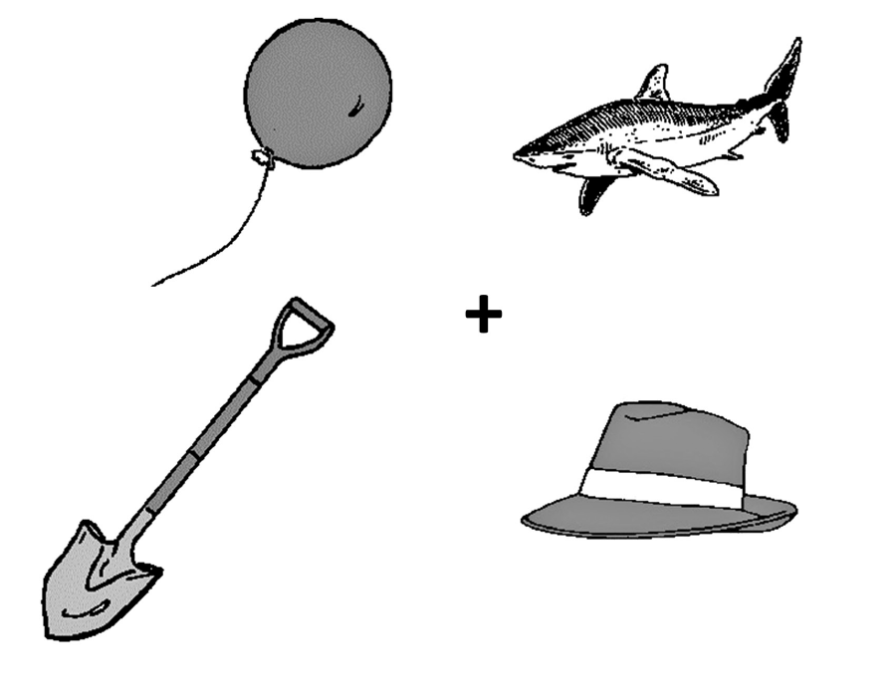
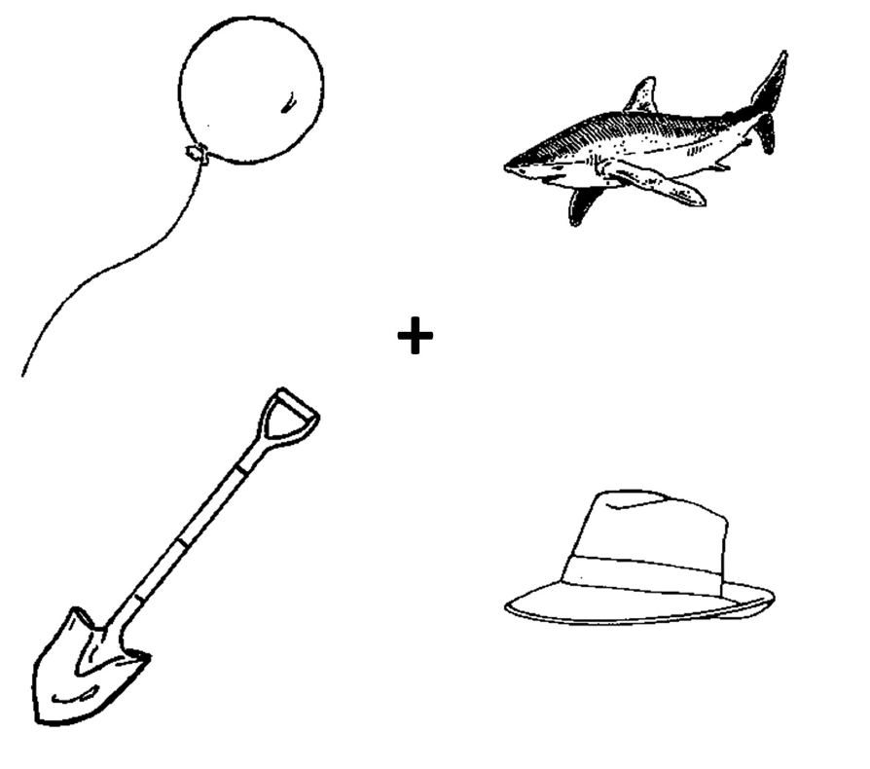
Selecting images
Marian & Spivey (2003)

Slide 34
Selecting images
All items should be comparable in visual salience
Control for animacy (i.e., a dog will elicit more looks than a hat)
Properties to consider are colour, size, brightness, and contrast, as well as spatial frequency (e.g., dense vs. sparse) and image style (e.g., line drawing vs. picture)
If eye fixations are divided roughly equally across the images at the onset of each trial (before the audio begins to play), you know you have done a good job.
If there are baseline effects, then you can make comparisons between conditions that present the same baseline effects (i.e., compare trials with the same display but different audio) or modify your data analysis to take these effects into account.

Slide 35
Where can I get good pictures?
International Picture Naming Project (https://crl.ucsd.edu/experiments/ipnp/)
Snodgrass and Vanderwart (1980) (https://pubmed.ncbi.nlm.nih.gov/7373248/)
Bank of Standardized Stimuli
(https://drive.google.com/open?id=1FpnEFkbqe_huRwfsCf7gs5R1zuc1ZOkn)

Slide 36
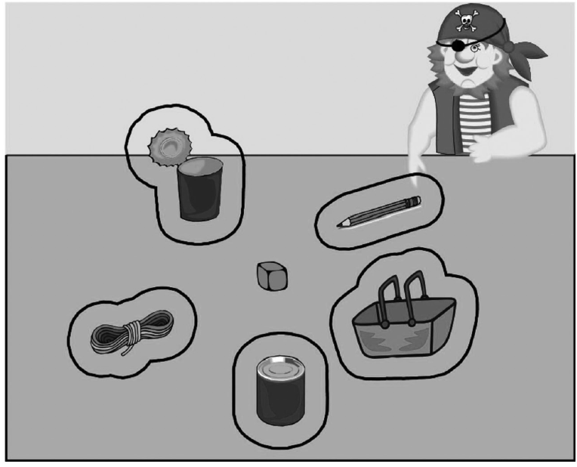
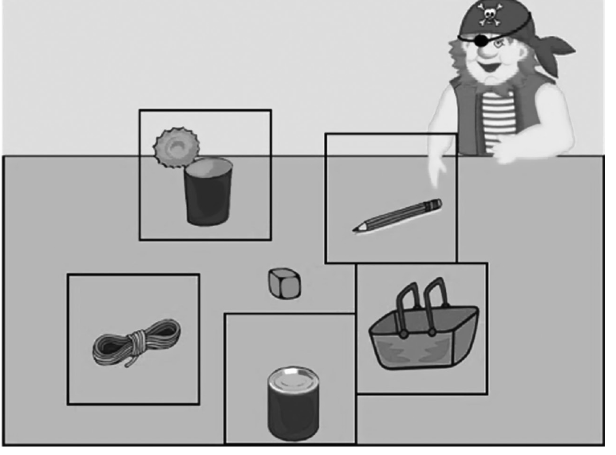
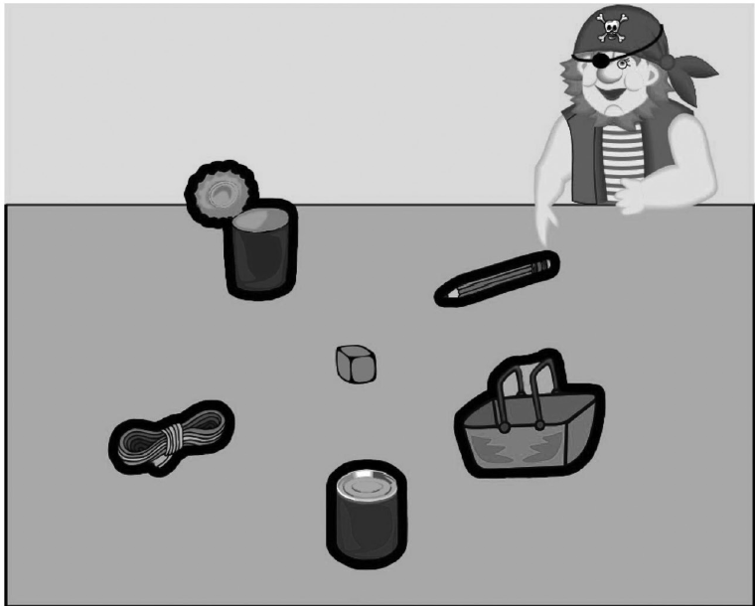
Defining Area/Region of Interest
Trenkic et al., 2014

Slide 37
Let’s reverse engineer the methodology
Each trial consisted of….
Preview time of 2.5 seconds (2500ms)
A fixation cross for 500ms
Audio + image with eye tracking recording.

Slide 38

Preview Time (2500ms)
Fixation Cross (500ms)
+
Audio + eye tracking
Finish when they click on an image
Wo ist das gelbe käse

Slide 39
Do we need a preview?
Dahan, Tanenhaus, and Salverda (2007) found L1 Dutch speakers showed effects of phonological competition, but only when they were given a preview.
Several researchers have found that length of preview could influence fixations on different objects in the display (e.g., Altmann & Kamide, 2009; Dahan & Tanenhaus, 2005; Hintz, Meyer, & Huettig, 2017; Huettig & McQueen, 2007; Kamide, Altmann, & Haywood, 2003)
Previews normally range from 1-4 seconds

Slide 40
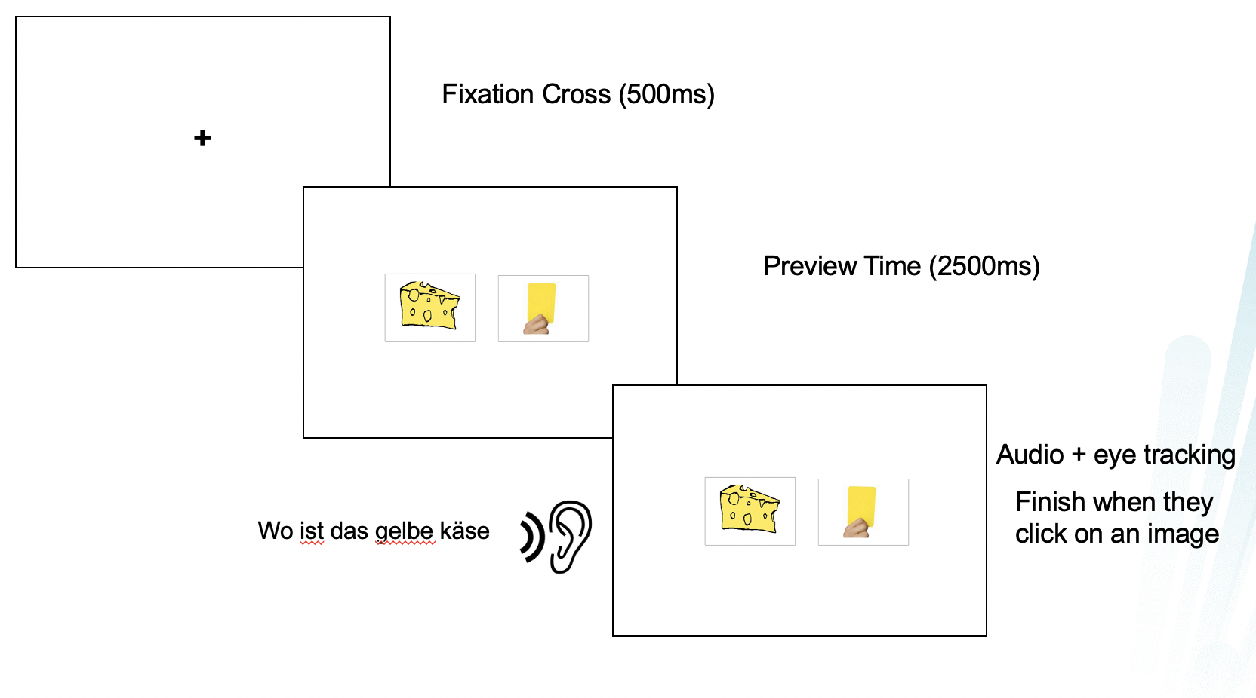
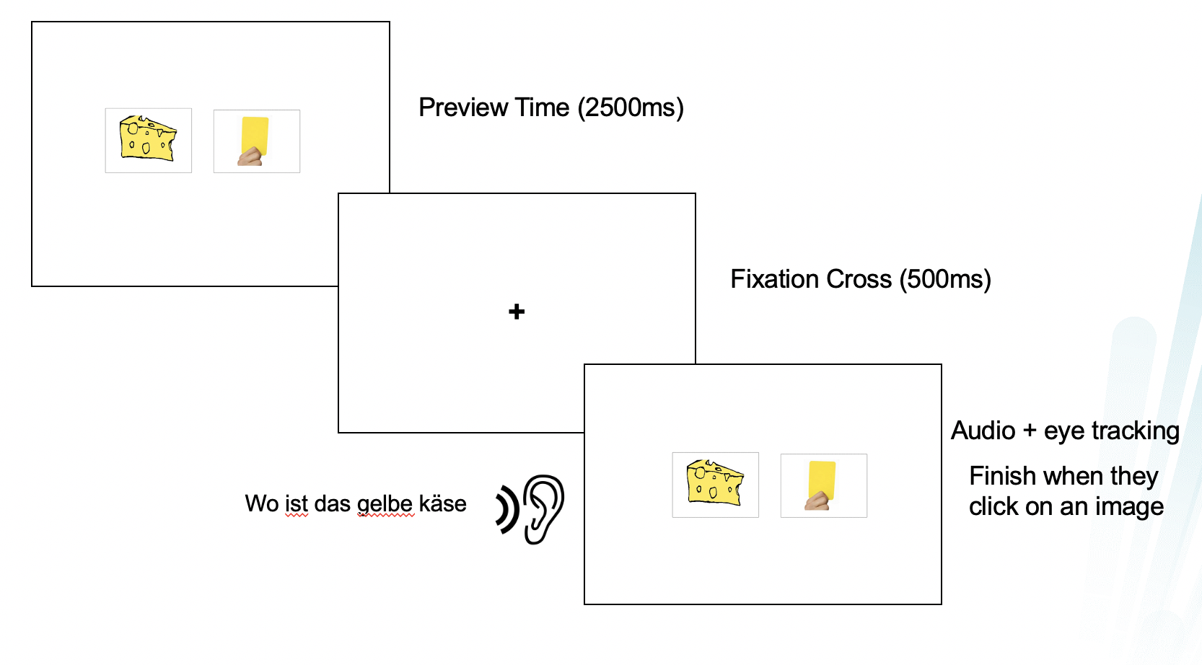
Do we need a fixation cross?
Fixations usually signal a new trial and equalizes the distance participants need to travel to the different images on the screen.

Slide 41

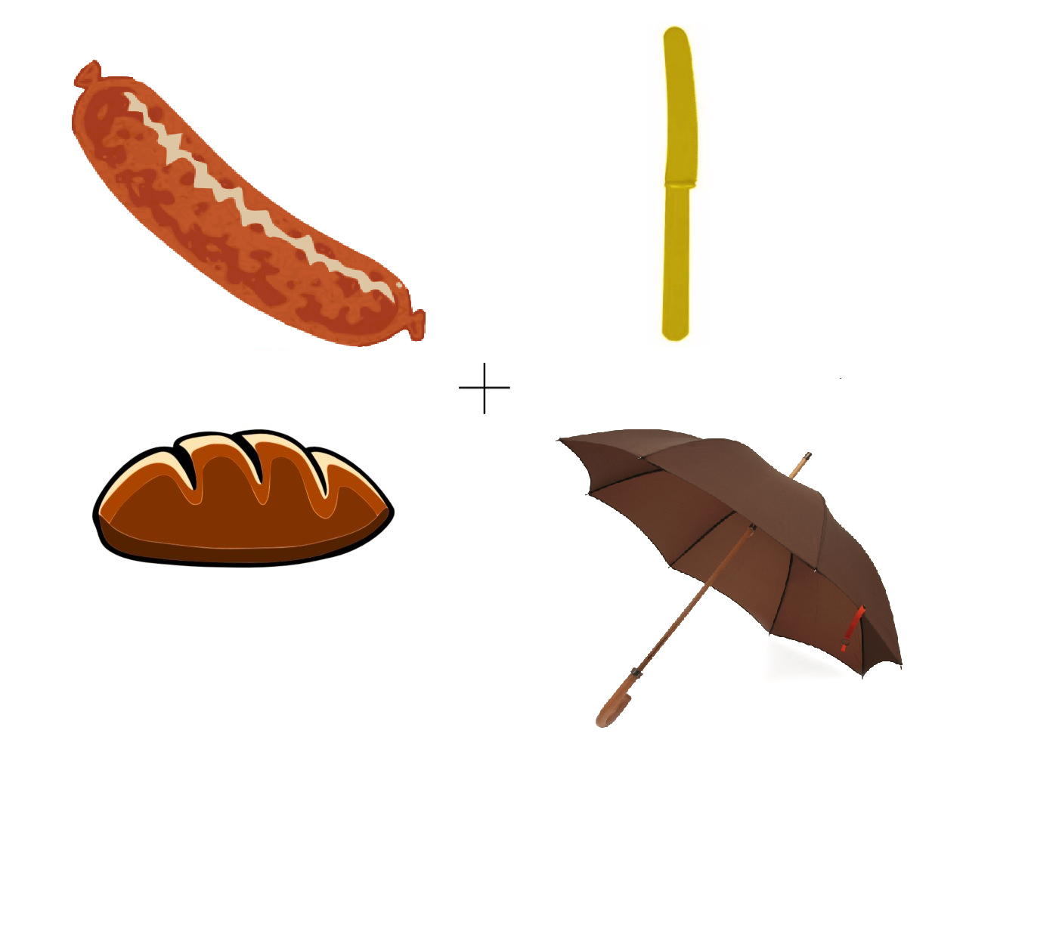
Hopp (2016)

Slide 42
Preparing Audio Materials
Know your participants! Are they L1 or L2 speakers? What’s their proficiency level?
Think about who is the most appropriate narrator (Native speaker? Bilingual? Male? Female?) and how they narrate (tone, pace, intonation)
Record in a studio with no background noise! (TEO hus 1 room 488)
When recording use mono mode (instead of stereo mode)
Record multiple times with different versions.

Slide 43
Very Important! Defining Time Windows
Wo ist das braune brot

Slide 44
Very Important! Defining Time Windows
Wo ist das braune brot

Slide 45
Very Important! Defining Time Windows
Wo ist das braune brot

Slide 46
Very Important! Defining Time Windows
Cue
Wo ist das braune brot
Prediction time window

Slide 47
Very Important! Defining Time Windows
Cue
Wo ist das braune brot
Carrier phrase

Slide 48
Let’s reverse engineer the methodology
Wo ist das braune brot
650ms
The onset of the adjective was aligned to occur 650 ms after determiner onset, and the onset of the nouns to 1,750 ms after the onset of the determiner.
Hopp (2016)

Slide 49
Let’s reverse engineer the methodology
Wo ist das braune brot
650ms
1750ms
The onset of the adjective was aligned to occur 650 ms after determiner onset, and the onset of the nouns to 1,750 ms after the onset of the determiner.

Slide 50
Let’s reverse engineer the methodology
Wo ist das braune brot
650ms
1700ms
1750ms
1700 ms

Slide 51
Let’s reverse engineer the methodology
Wo ist das braune brot
650ms
1700ms
1750ms
1700 ms
2350 ms

Slide 52
Let’s reverse engineer the methodology
Wo ist das braune brot
650ms
1700ms
1750ms
1700 ms
2350 ms
3450 ms

Slide 53
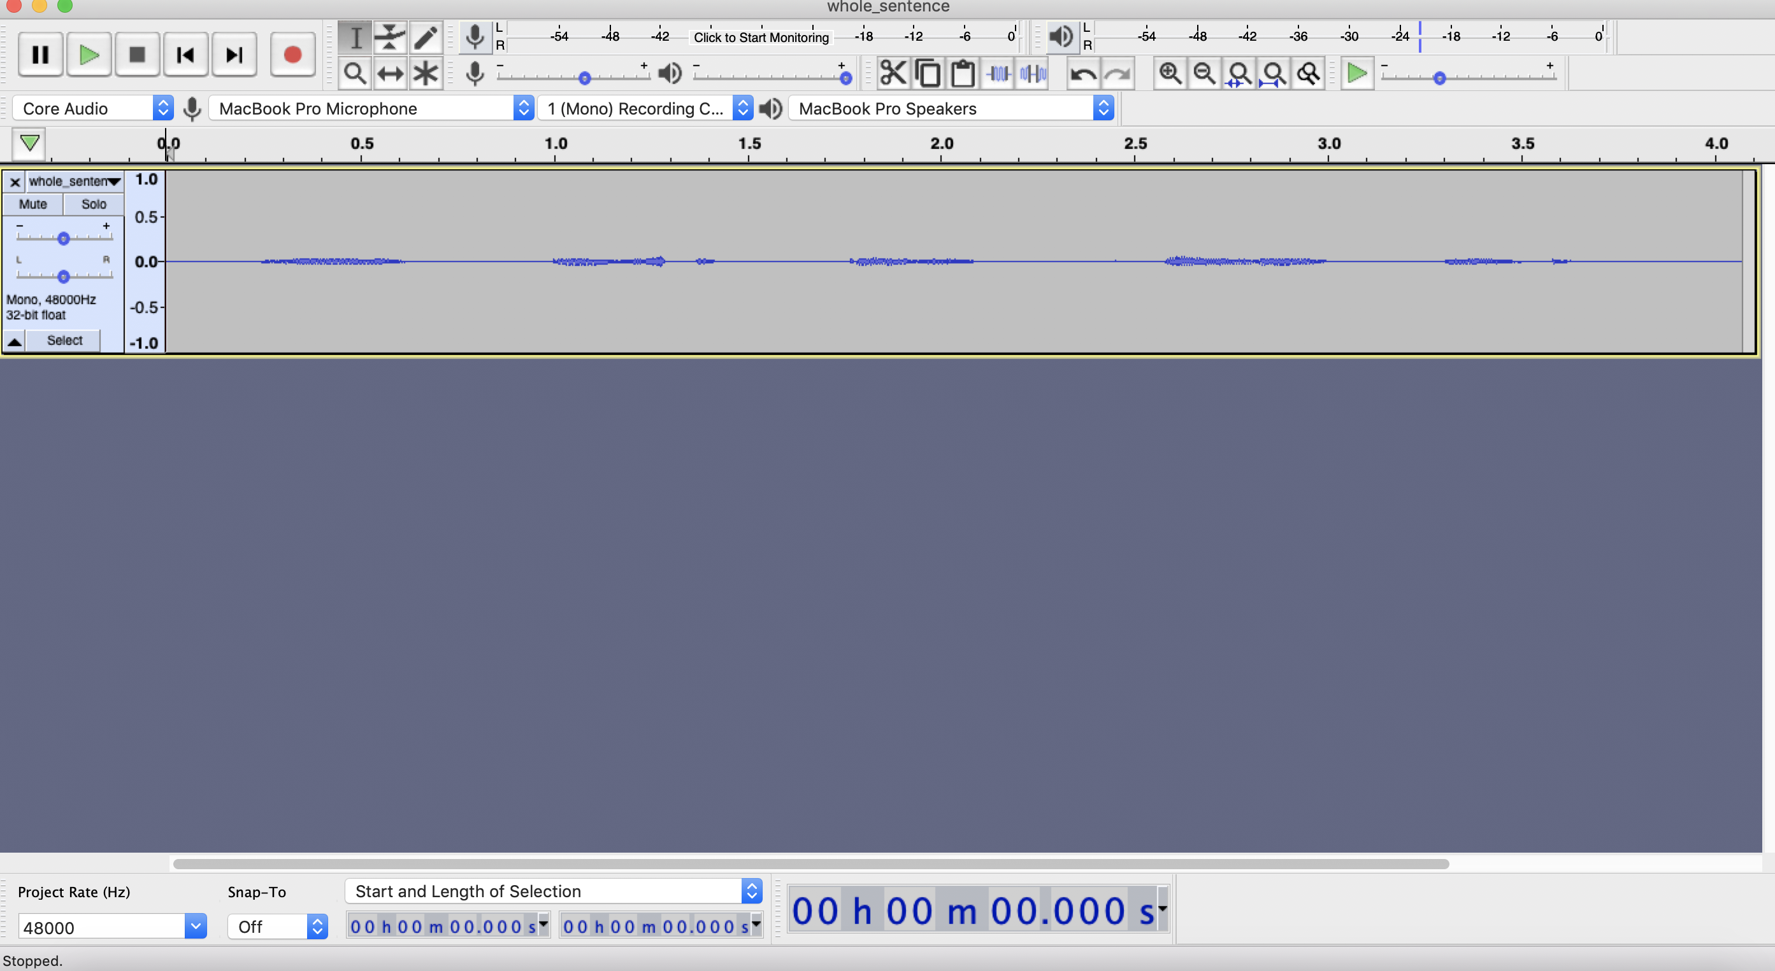
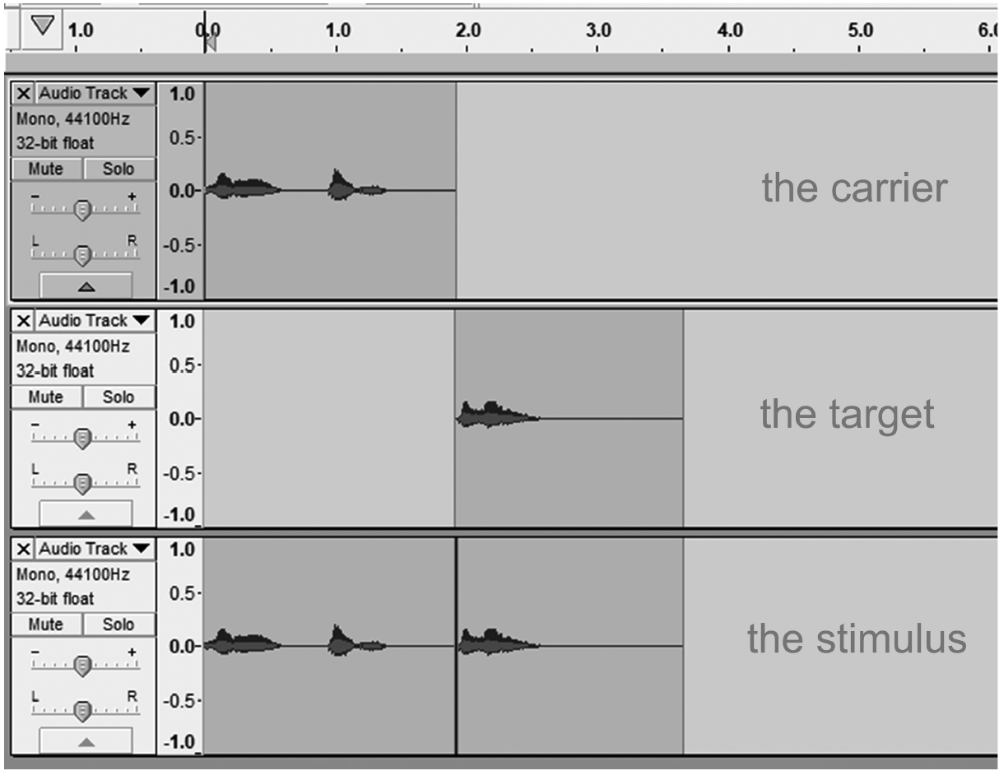
Splicing
Whole sentence vs.

Slide 54
Let’s create audio stimuli using Audacity!

Slide 55
See you on Wednesday at 9am!

